Slide 1
Project in
Generative Adversarial Networks
Alexander Mennborg
Ismat Halabi
Elliot Härenby Deak

Slide 2
Table of Contents
Introduction
What are GANs?
How does GANs work?
Deep Convolutional GANs
Training results

Slide 3
Introduction
Initial goal generate CIFAR10 images
Using generative adversarial networks

Slide 4
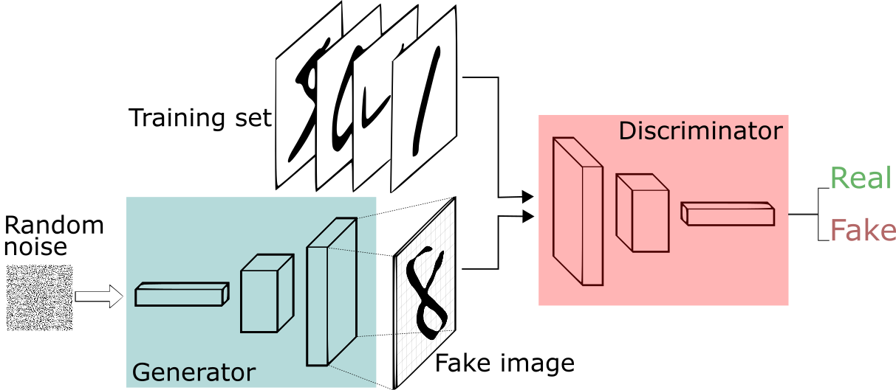
What are GANs?
Generative algorithms very hard to train
Idea: evaluate real/ fake images
Training adversary

Slide 5
How does GANs work?
Generator
Input: random noise, Output: generated image
Recognizes many features, upscales
Discriminator
Input: image, Output: two classes (real/ fake)
Opposite to generator, downscales
Training, first discriminator then generator

Slide 6
Deep Convolutional GANs
Using CNNs for both models
Discriminator - standard image classifier (e.g. AlexNet, 2 output classes)
Generator - inverse of discriminator (except input is typically larger)
Guidelines - Use batch norm., no pooling, ReLU (G) and LeakyReLU (D)
Downsampling
(strided convolution)
2x2 output
⇑
5x5 input
Upsampling
(fractional strided convolution)
5x5 output
⇑
3x3 input (padding)
Gifs taken from: https://github.com/vdumoulin/conv_arithmetic

Slide 7
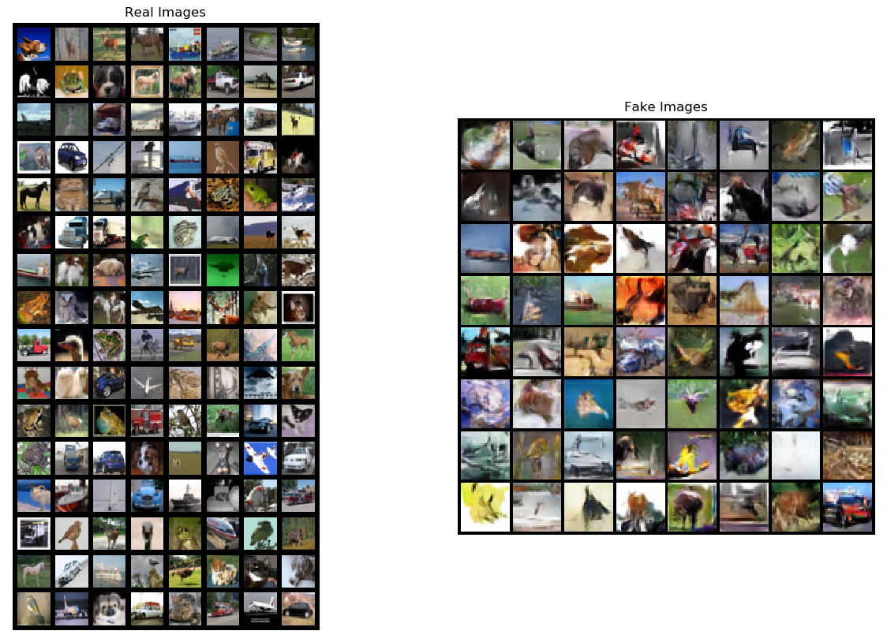
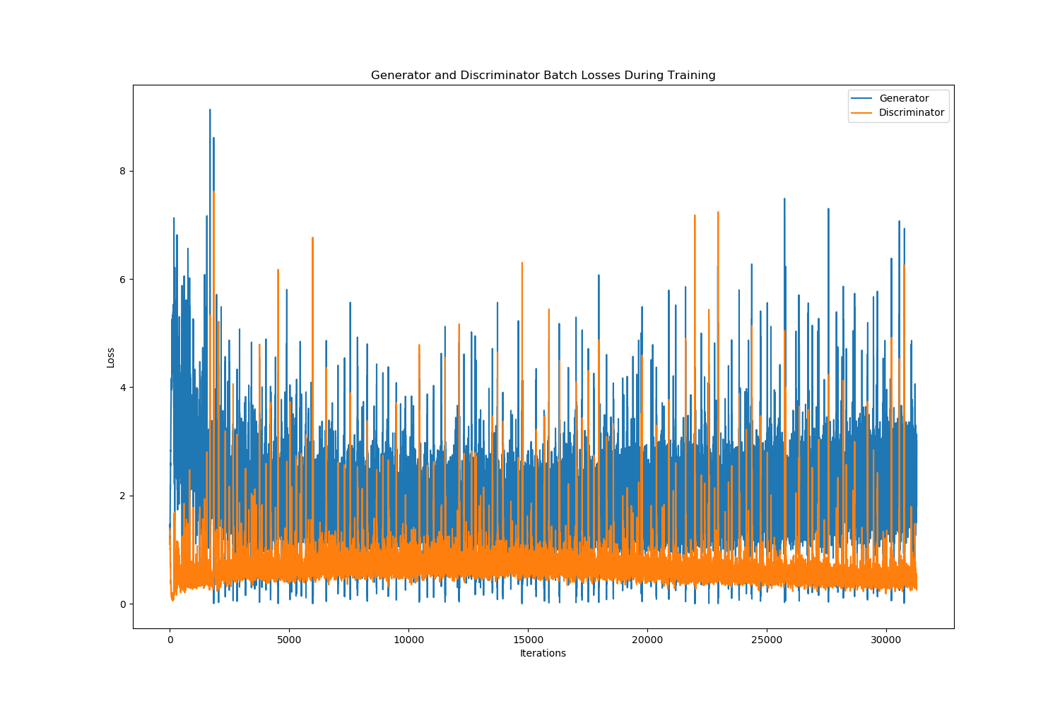
Training Results
Training, quite unstable
Fake images, blurry, CIFAR10 like
After 60 epochs, G loss increased

Slide 8
References
Alec Radford, Luke Metz, Soumith Chintala. Unsupervised Representation Learning with Deep Convolutional Generative Adversarial Networks, 2016.

